Slide 1
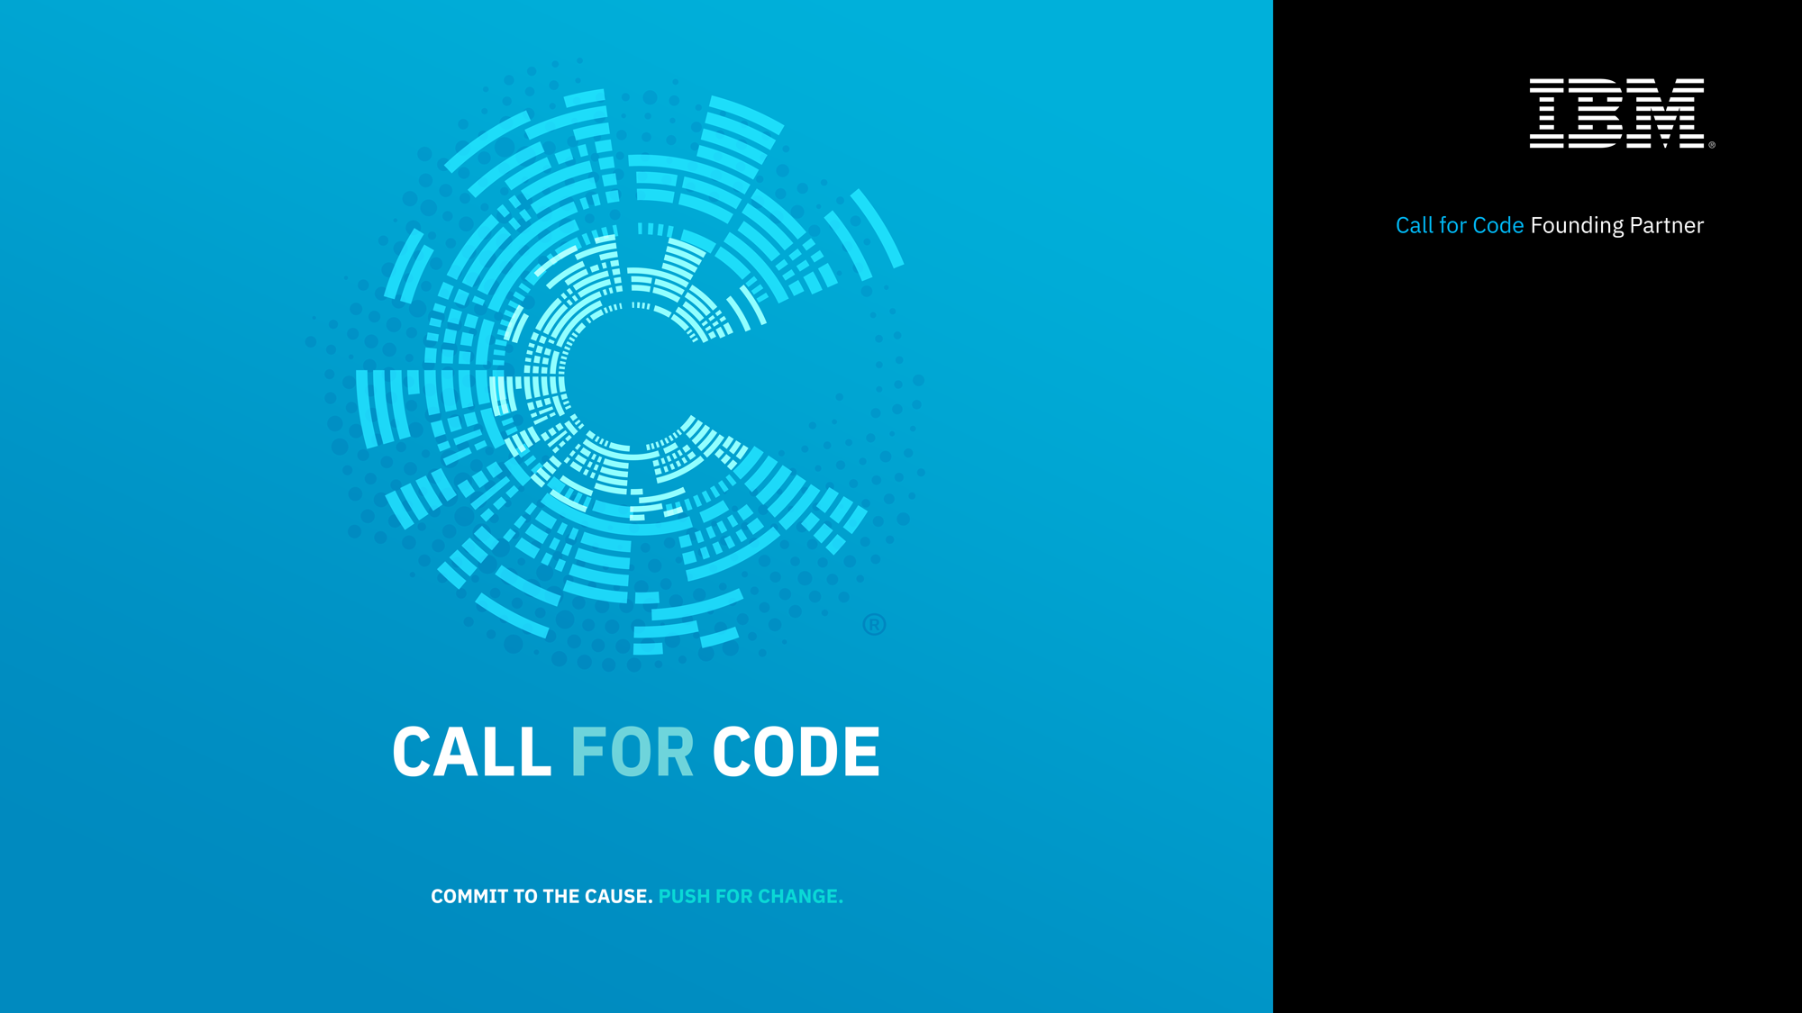

Slide 2

Introductions and Logistics
What is Call for Code?
Use Cases and Code Pattern examples
Judging and Submission Key Rules

Slide 3
CALL FOR CODE DAY AGENDA – DAY 1
Kickoff (here)
Team Formation / Ideation / Study Use Cases
Lunch
Examine reference patterns or dive in
Begin coding
Dinner
Continue coding...

Slide 4
CALL FOR CODE DAY AGENDA – DAY 2
Breakfast
Pitch Workshop
Open submissions
Lunch
Code freeze, submissions due
Judging expo
Awards and after party

Slide 5
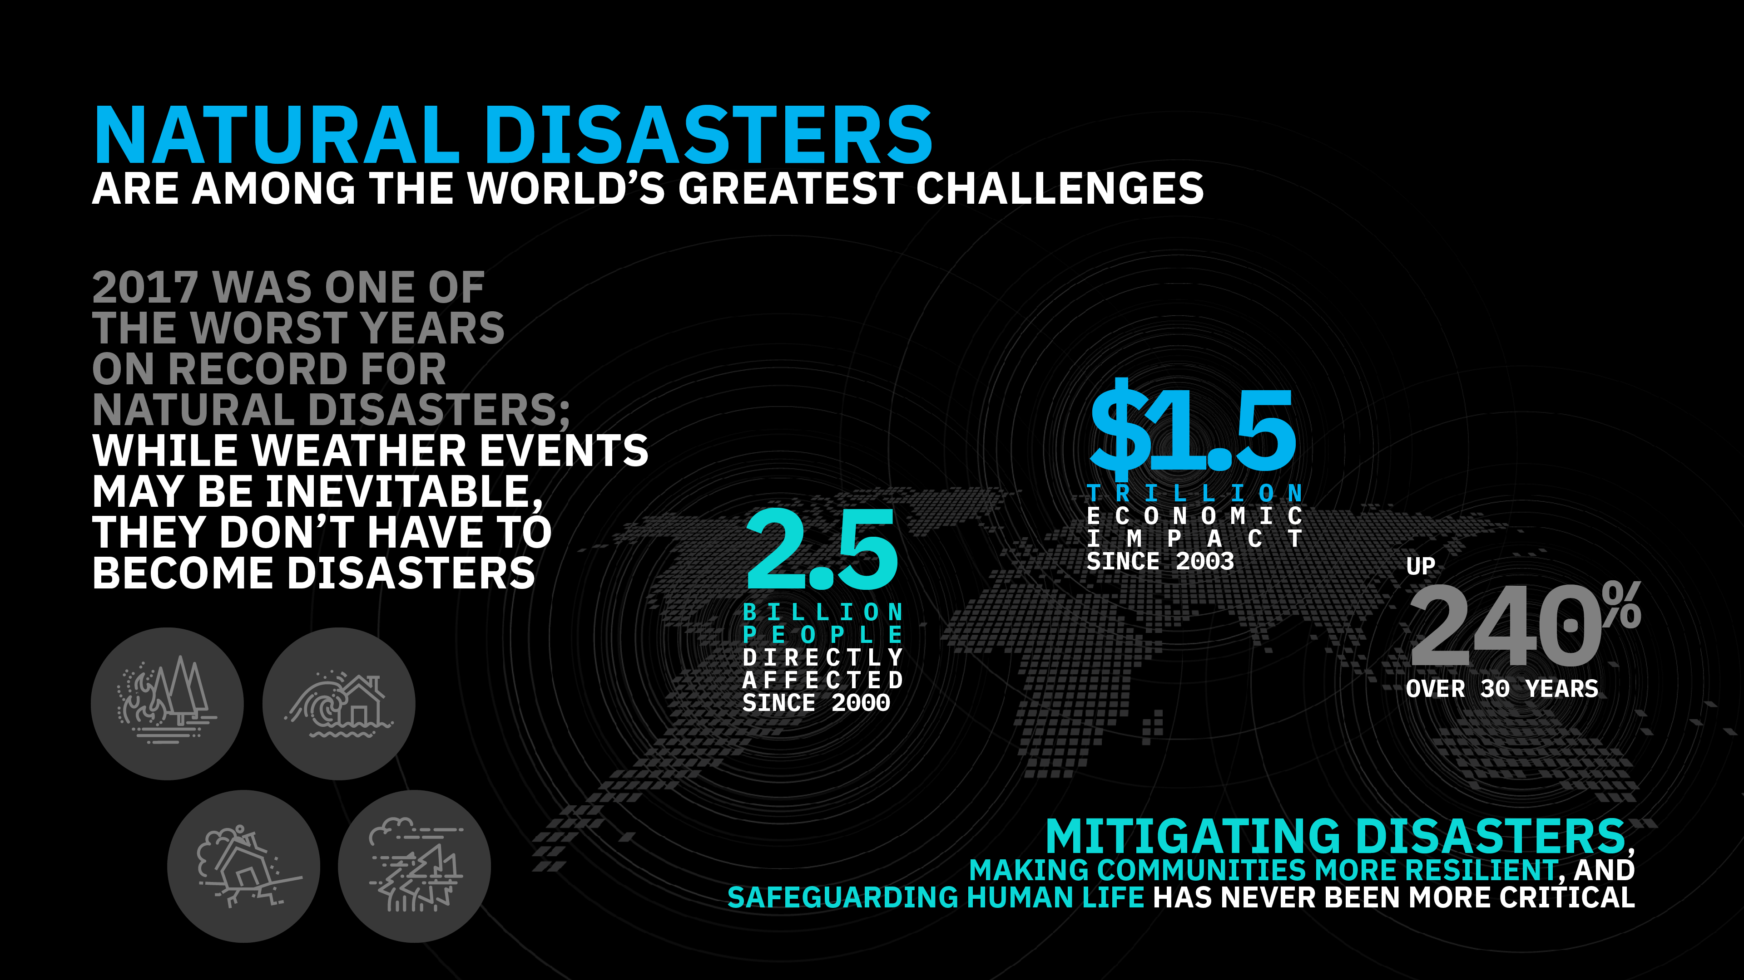
Notes:
Through our long history of working with the world’s developers, particularly in the open source community, we know their impact as the builders of modern business. We also know, through our long history of leading the industry to leverage technology for societal good, that developers can have a similar impact as the builders of a better society – both in ethical considerations for how technology is built and more directly in the use of their skills to address some of the most pressing problems of our modern world.

Slide 6
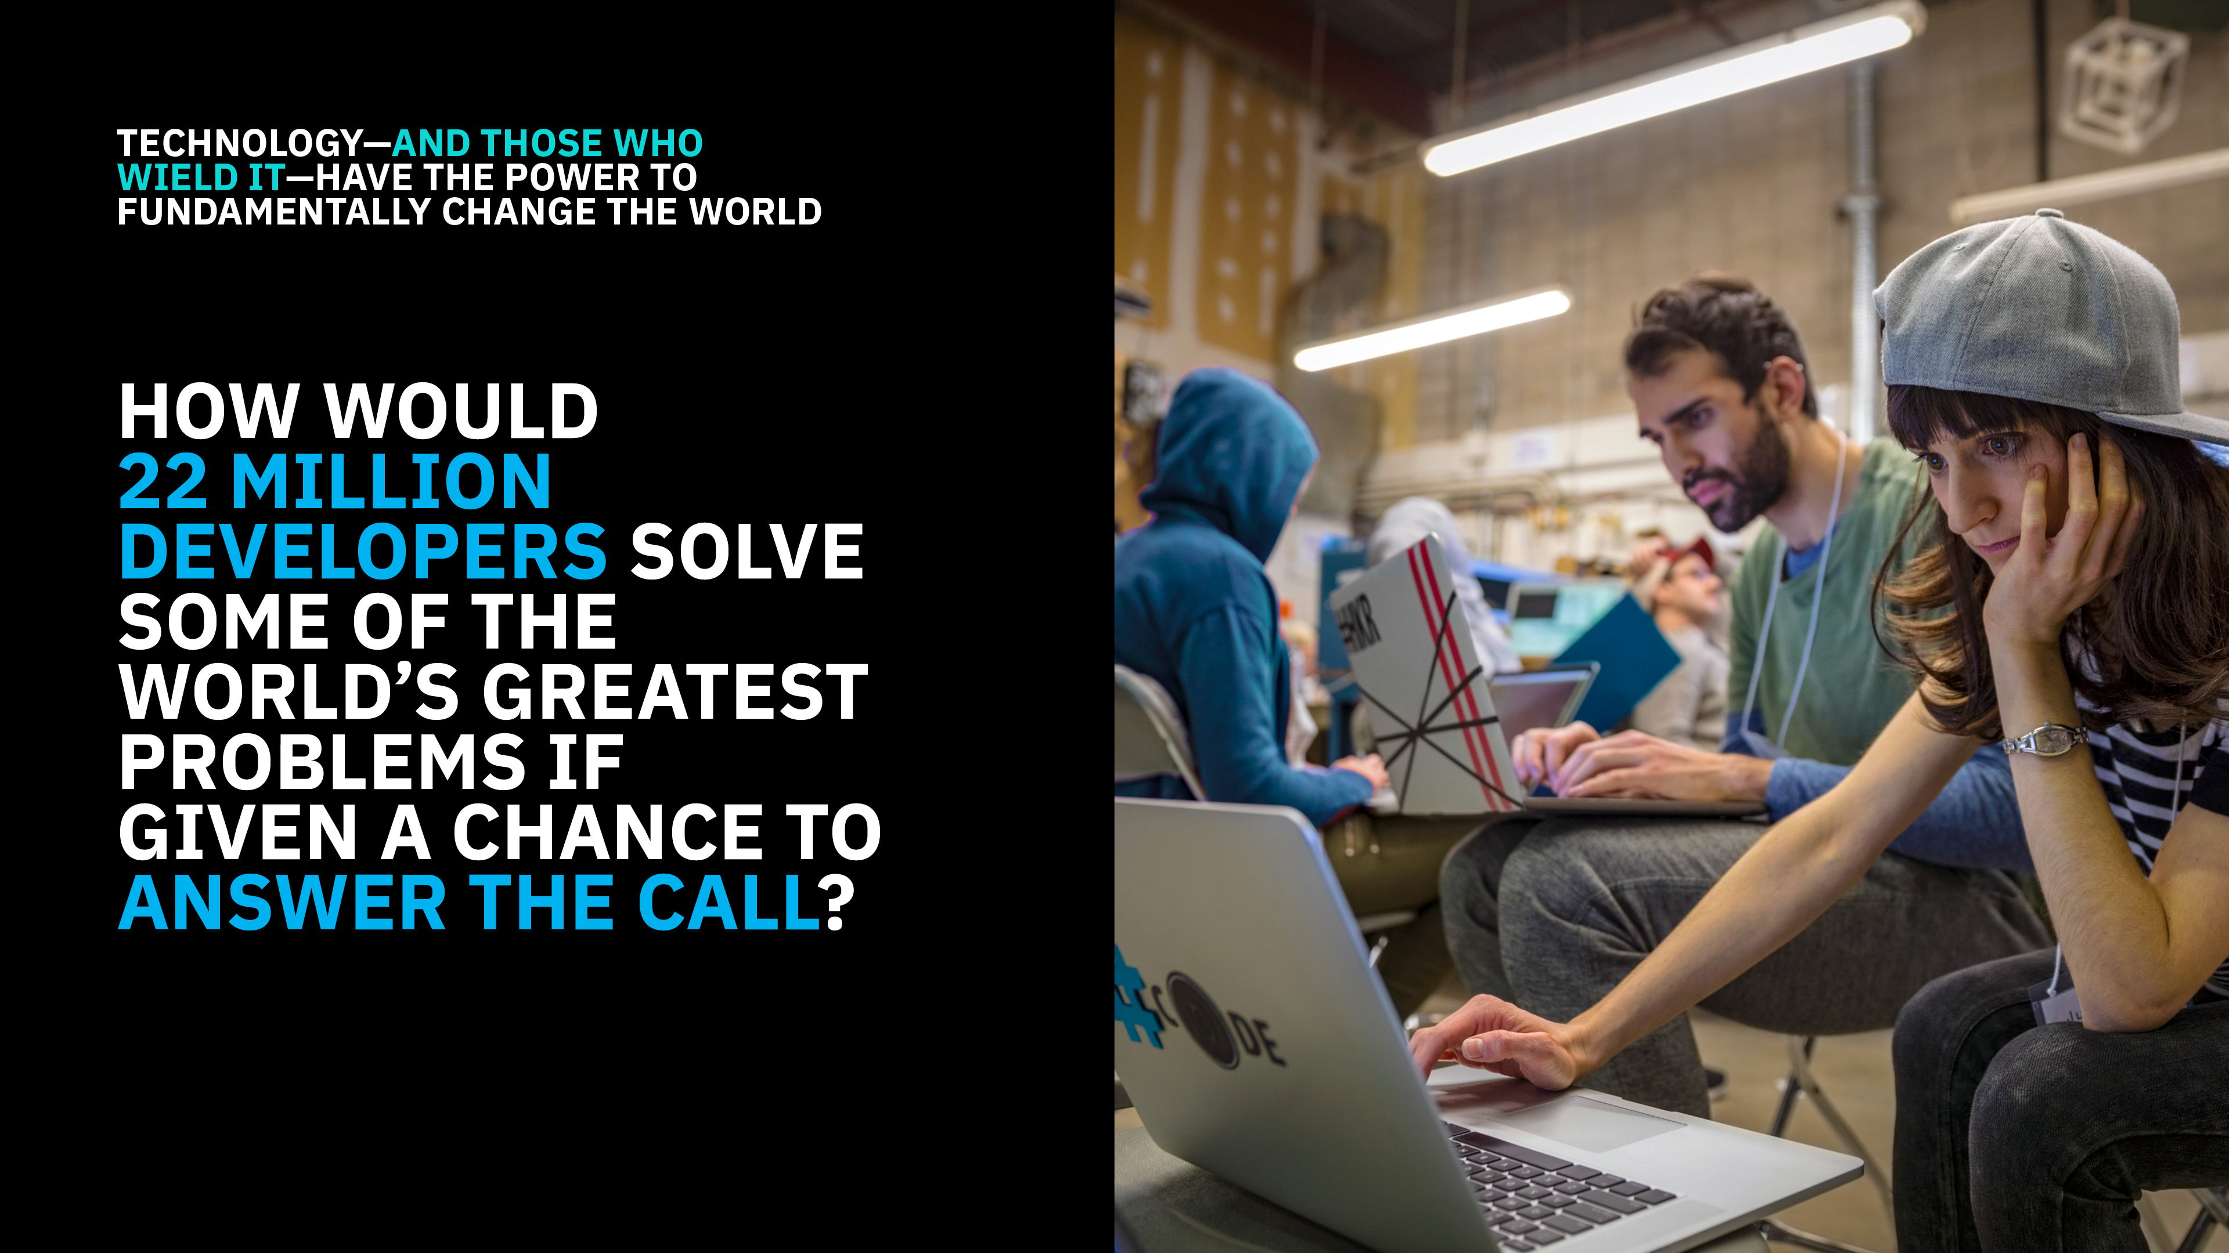

Slide 7









Charitable Partners
GRAND PRIZE
The Call for Code Global Award selected by a jury of eminent technologists and presented at the Call for Code Award Event
A $200,000 USD Cash Prize
Long-term open source project support from The Linux Foundation
Venture capitalist introduction with NEA and pitch opportunity to turn your idea into a funded company
The chance to deploy your solution with an IBM Corporate Service Corps team on the ground
Creator
Founding Partner
Program Affiliates
Gold Sponsor
FIRST AND SECOND RUNNER UP
Invitation to the Call for Code Award Event
A $25,000 USD cash prize
Long-term open source project support from The Linux Foundation
Program Supporter
Notes:
So the Call for Code Challenge aims to provide a prize structure that encourages developers to build long-lasting, high quality applications that live on long past the next two months of the challenge.
There’s an award presented by the non-governmental organizations, cash prizes, and support for deploying the winning application as a supported open source project, and put into use on the ground in the areas of greatest need, along with the opportunity for a team to build a company around the idea.

Slide 8

CHALLENGE
Create solutions that significantly improve preparedness for natural disasters and relief when they hit in order to safeguard the health and well-being of communities.
Consider long-term, short-term, mid-crisis, and recovery timeframes.
UNITED NATIONS SENDAI FRAMEWORK: TARGETS AND PRIORITIES
RED CROSS STRATEGY 2020:
STRATEGIC AIMS
Notes:
The overall challenge scope is broad. Save lives by preparing communities for disaster, and helping them recover stronger.
The UN and Red Cross have frameworks available that can help guide you as to the priority areas where technology can help, as well as the targets they hope to achieve to measure success.
They can serve as roadmaps to help you solve the right problems.

Slide 9
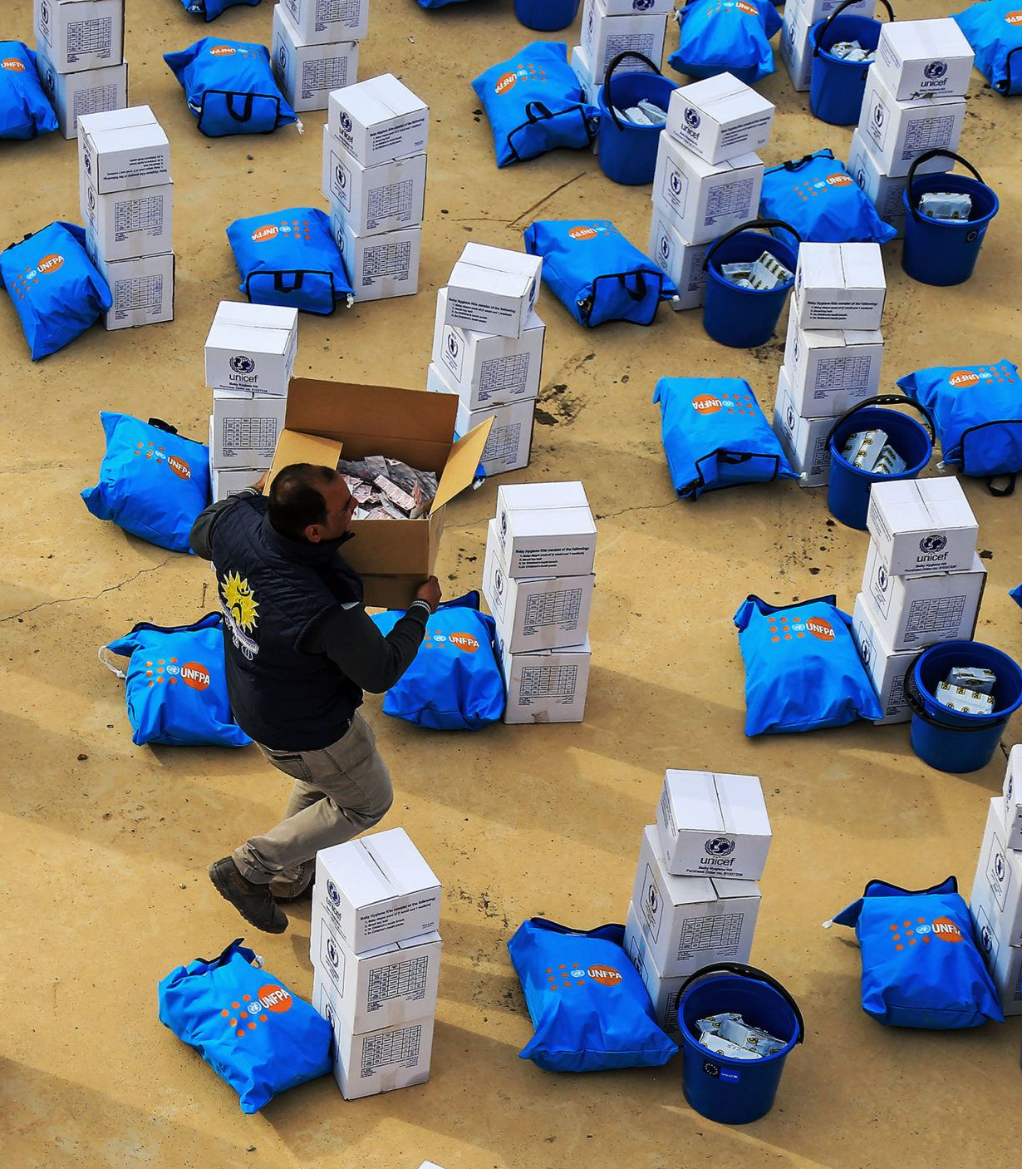
Code Patterns
Build a blockchain network
Deploy an asset-transfer app using blockchain
Create a real-time payments application
Track financial donations with blockchain
Automate business processes via blockchain events
Create financial applications using APIs on mainframe
Build resilient financial networks to execute secure transactions quickly
developer.ibm.com/callforcode/resources/financial-networks/

Slide 10

Code Patterns
Create a mobile written Hangul translation app
Analyze Twitter handles and hashtags for sentiment and content
Deploy a serverless multilingual conference room
Create an app to perform intelligent searches on data
Translate
voice and written communications on the fly to improve information sharing
developer.ibm.com/callforcode/resources/translate/

Slide 11

Code Patterns
Classify ICD-10 data with Watson
Develop a web-based mobile health app that uses machine learning
Create and deploy a scoring model to predict heart rate failure
Create visualizations to understand food insecurity
Analyze open medical datasets to gain insights
Understand, analyze, and predict healthcare and nutrition needs to improve basic services
developer.ibm.com/callforcode/resources/healthcare/

Slide 12
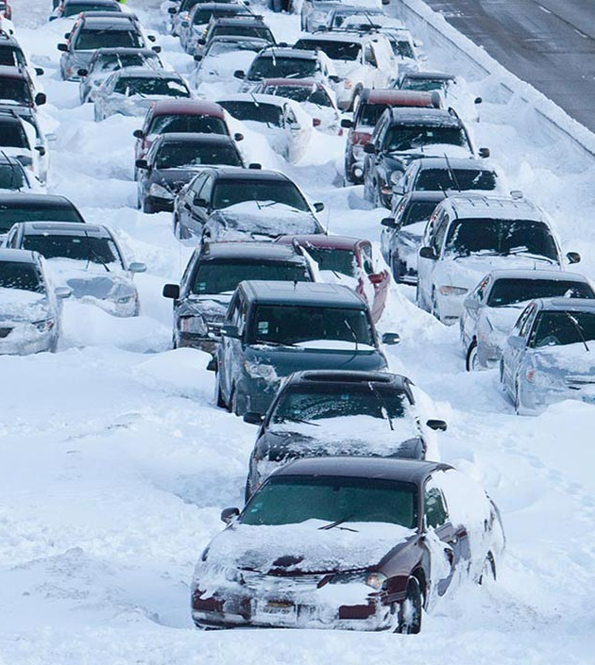
Code Patterns
Build a cognitive recommendation app with Swift
Correlate flight and weather data in an augmented reality mobile app
Create charts, graphs, and maps using open city datasets
Improve logistics based on traffic and weather activity to reduce number of people affected
developer.ibm.com/callforcode/resources/traffic-and-weather/

Slide 13

Code Patterns
Analyze industrial equipment for defects
Detect voltage anomalies in household IoT devices
Develop an IoT asset tracking app using Blockchain
Use MQTT to stream real-time data
Analyze device sensor data to take corrective or preventative action automatically
developer.ibm.com/callforcode/resources/preventative-action/

Slide 14
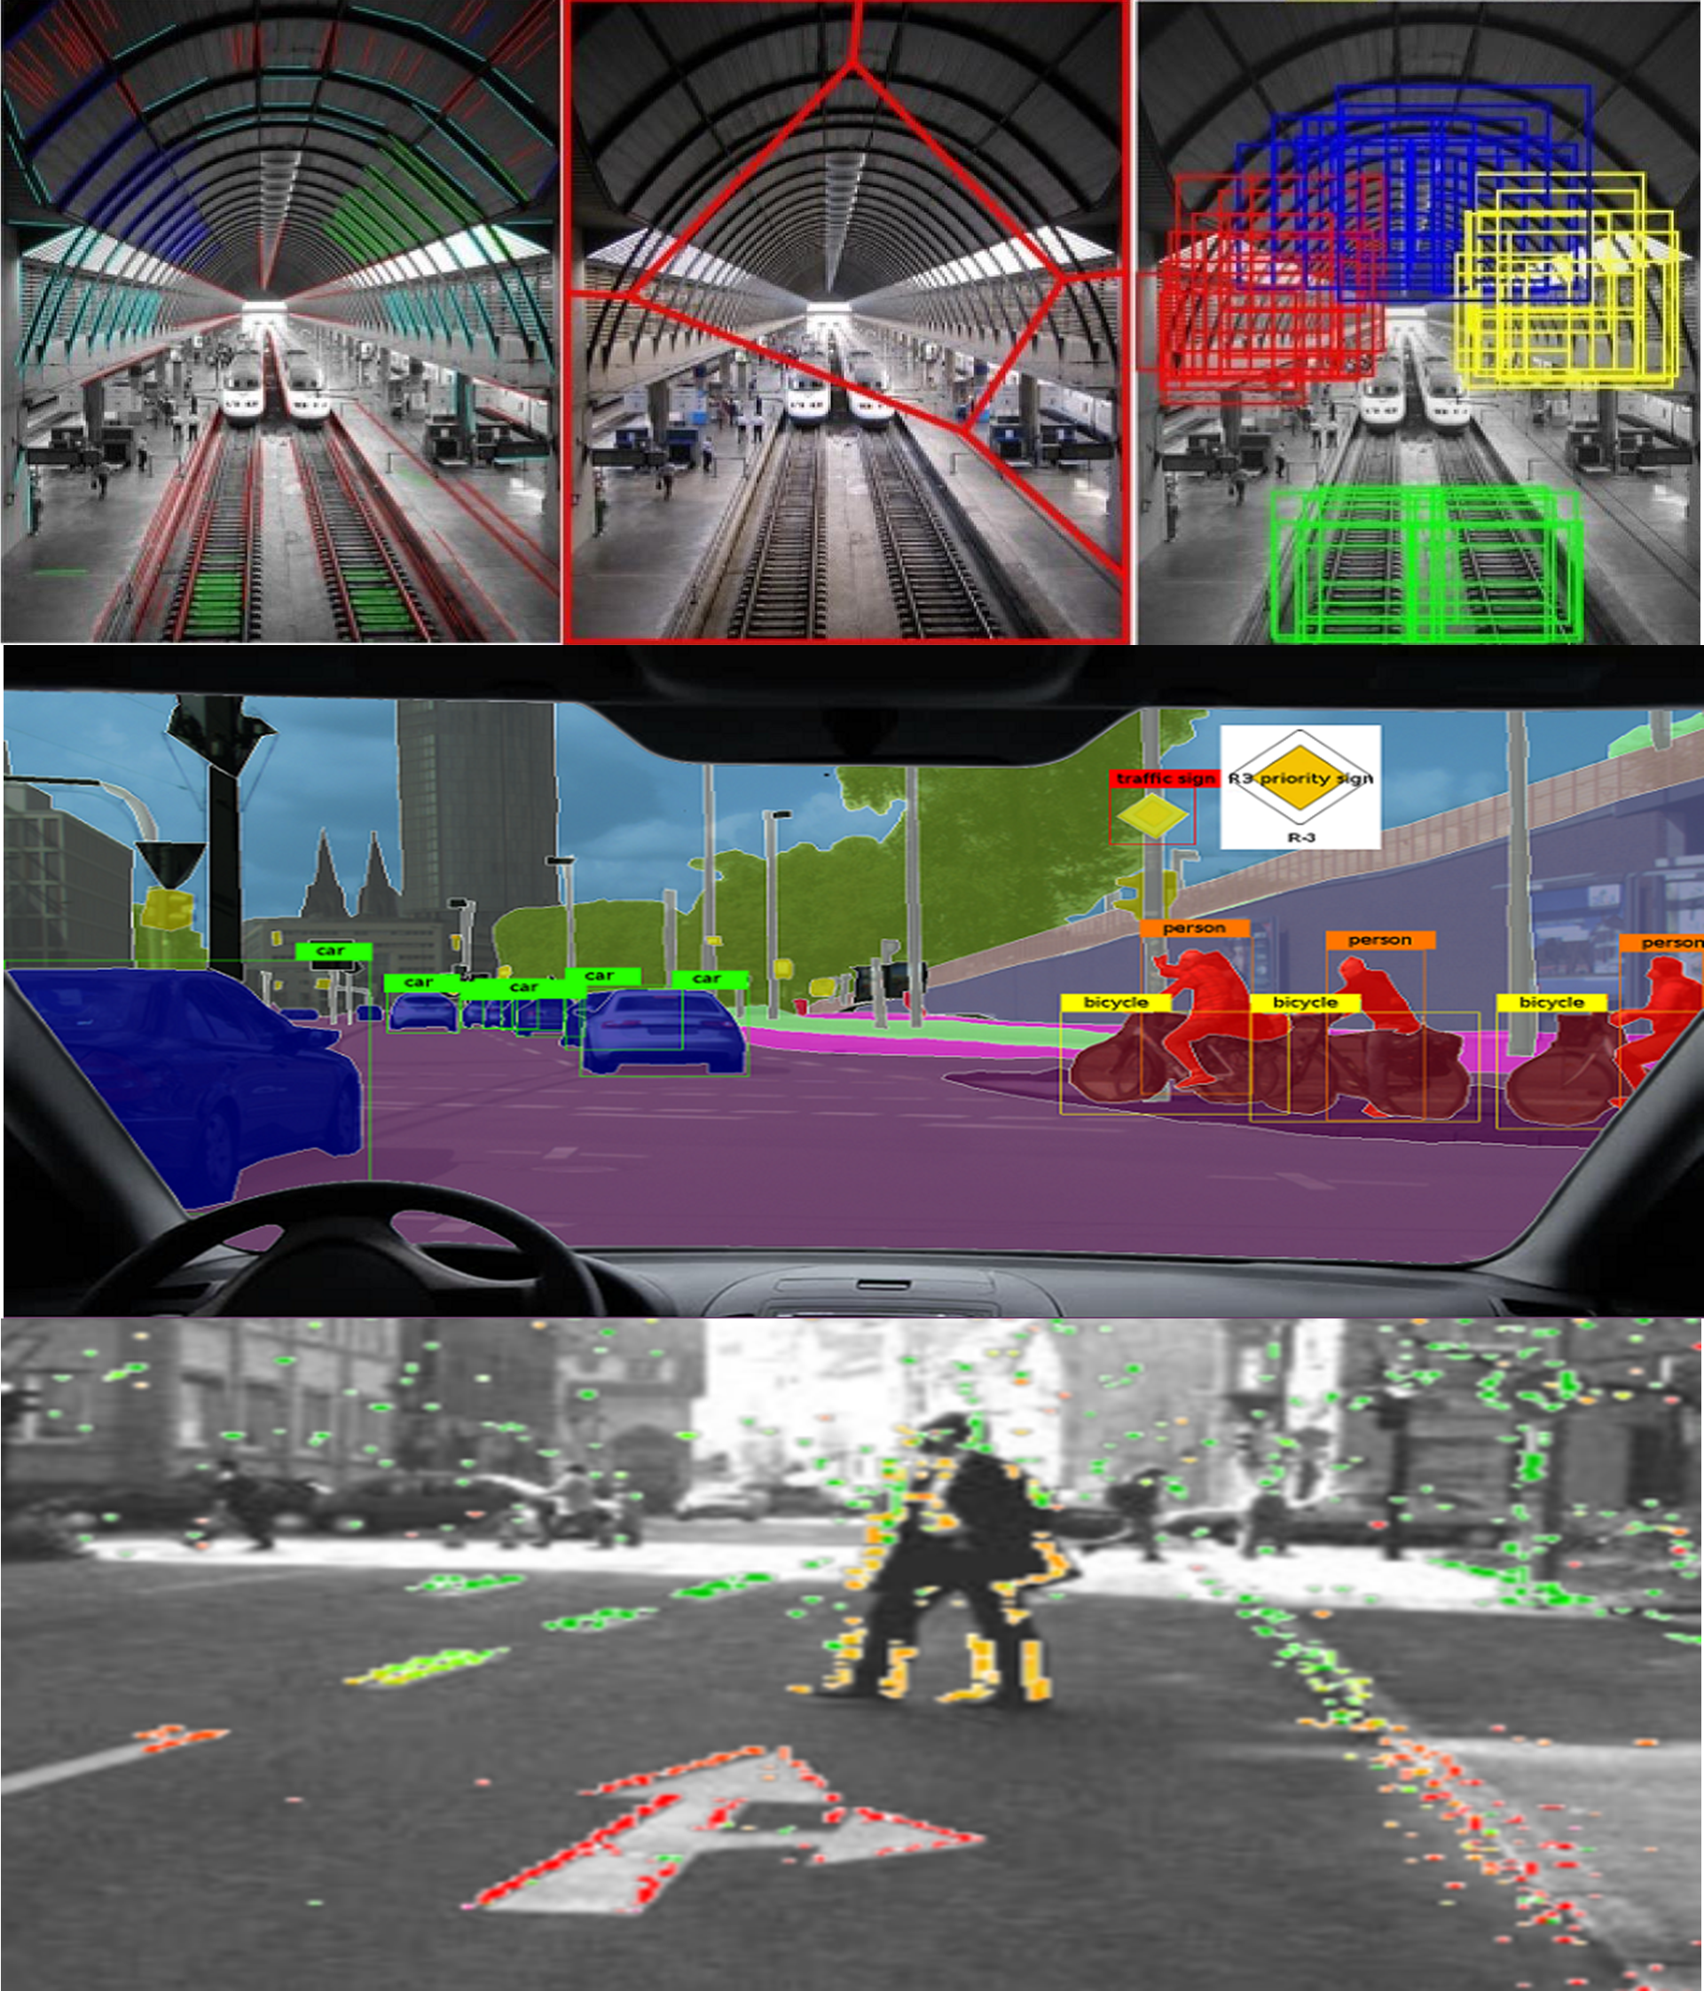
Code Patterns
Build an iOS game powered by Core ML and Watson Visual Recognition
Locate and count items in an image with object detection
Classify vehicle damage images
Deploy Tensorflow on Kubernetes
Use visual recognition to process claims quickly or identify immediate need for aid
developer.ibm.com/callforcode/resources/visual-recognition/

Slide 15
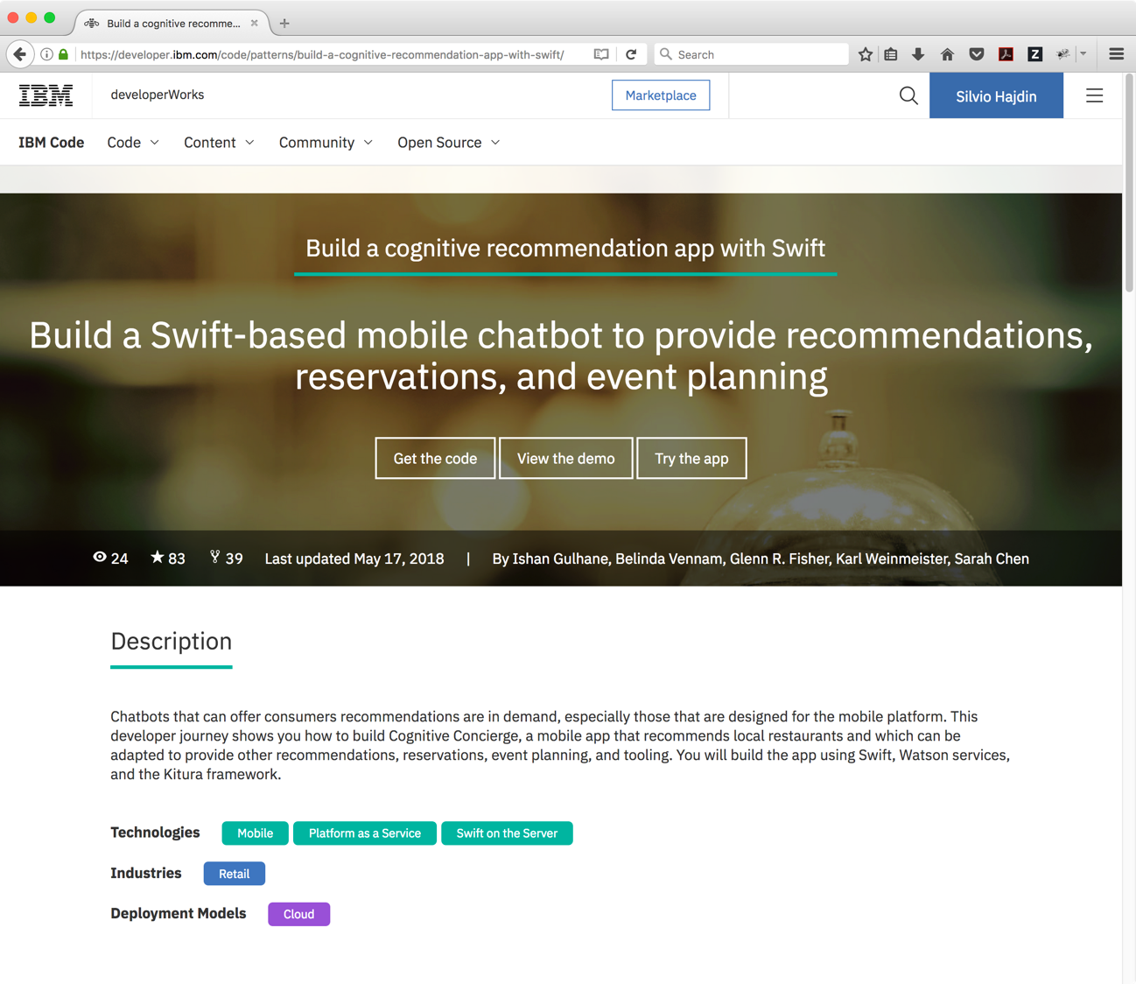
DEPLOY NEW APPLICATIONS QUICKLY WITH CODE PATTERNS, ROADMAPS FOR SOLVING COMPLEX PROGRAMMING CHALLENGES
Notes:
Those Code Patterns will be your primary way to explore working examples of IBM Cloud services. They all have a use case description, GitHub repos, and architecture diagrams.
Beyond the ones that have been highlighted for this competition, there are over one hundred additional code patterns to explore on developer.ibm.com/code

Slide 16
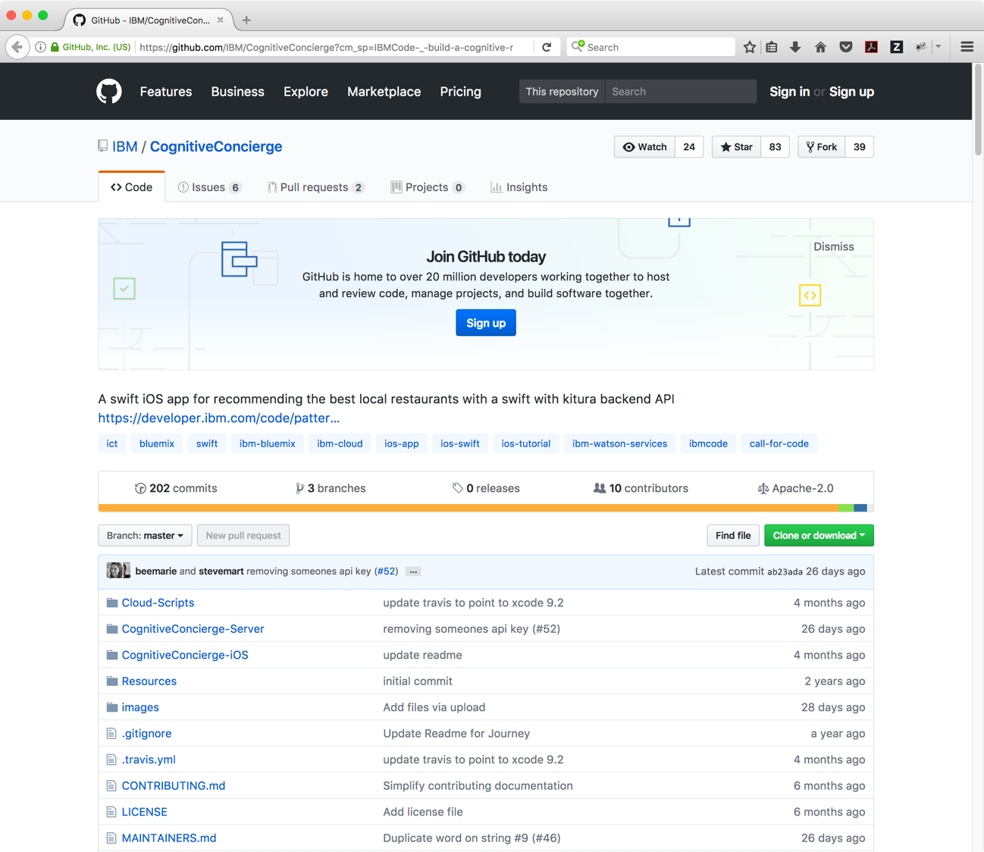
CODE PATTERNS PROVIDE A 360-DEGREE VIEW OF THE UNDERLYING CODE, INCLUDING OVERVIEWS, ARCHITECTURE DIAGRAMS, PROCESS FLOWS, REPO POINTERS, AND ADDITIONAL READING
Notes:
The GitHub repos also have more in depth documentation and many have a one-click deploy to the IBM Cloud option.

Slide 17
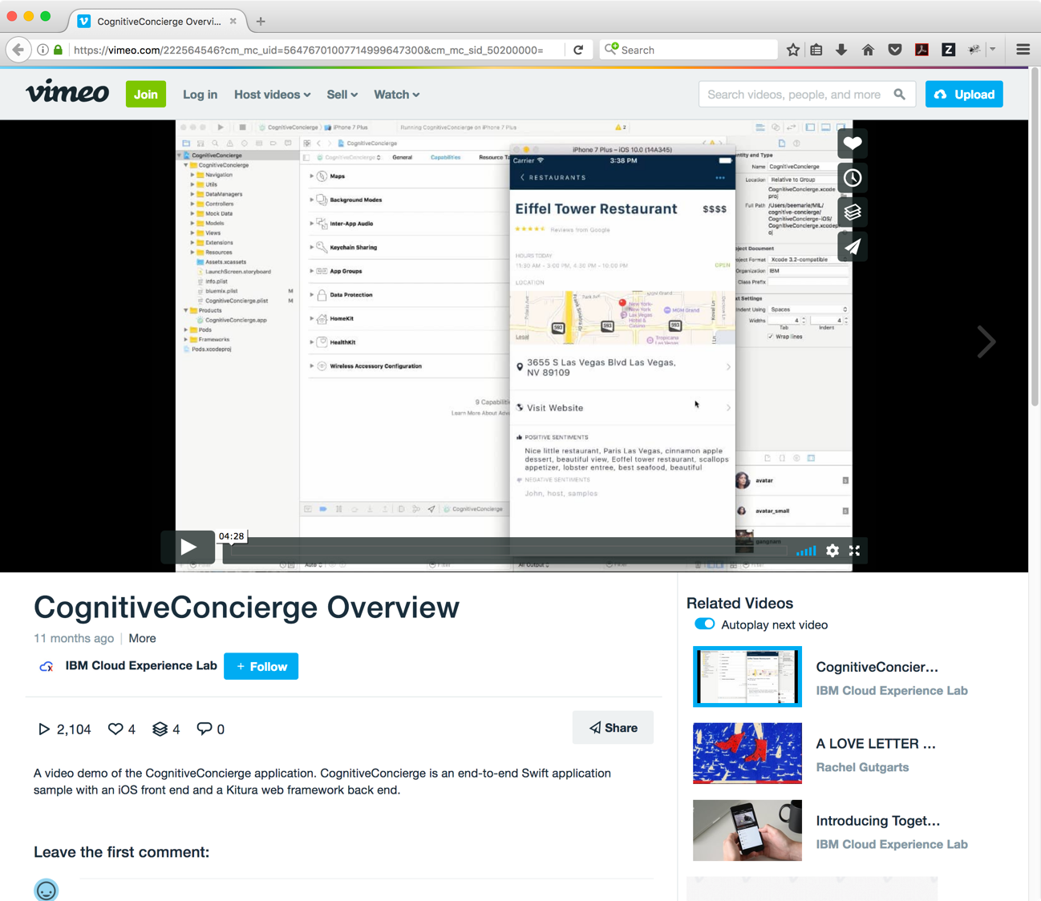
VIEW STEP-BY-STEP INSTRUCTIONAL VIDEOS SHARED BY EXPERT DEVELOPERS
Notes:
And many of them have associated demo videos as well.

Slide 18
STEP 1:
REGISTER FOR THE CHALLENGE
callforcode.org/challenge
LEARN ABOUT THE COMPETITION SCOPE, PRIZES, RULES, AND SCHEDULE
STEP 2:
SIGN UP FOR AN IBM ACCOUNT
bit.ly/ibm-acct
GET AN IBM CLOUD ACCOUNT GRANTING FREE TIER ACCESS PLUS $200 CREDIT
STEP 3:
START BUILDING WITH CODE PATTERNS
developer.ibm.com/callforcode
USE CODE PATTERNS IN SIX TECH AREAS TO INSPIRE YOUR SUBMISSION
STEP 4:
ENGAGE THE COMMUNITY
ibmcoders.influitive.com
callforcode.slack.com
MEET ADVOCATES, BRAINSTORM IDEAS, FIND A TEAM, HEAR ABOUT UPDATES

Slide 19
HACK JUDGING NOTES
Working code > Slides
Convey a user-centered story with your demonstration
Show how technologies work together
More tips in the Pitch Workshop!!!
Criteria | Points
Completeness and transferability | 5
Effectiveness and efficiency | 5
Design and usability | 5
Creativity and innovation | 5
Idea
User Experience
Implementation

Slide 20

JUDGING
5 POINTS FOR EACH (20 TOTAL)
COMPLETENESS AND TRANSFERABILITY
How fully has the idea been implemented? Can it achieve an impact in the field? Can it be transferred elsewhere?
EFFECTIVENESS AND EFFICIENCY
Does the solution address a high priority area? Does it achieve its goal effectively and efficiently? Can it scale?
DESIGN AND USABILITY
How good is the design, user experience, and ease of use of the solution? How quickly can it be put to use?
CREATIVITY AND INNOVATION
How unique was the approach to solving a long-standing or previously intractable problem?

Slide 21

KEY RULES
ACCEPT THE PARTICIPATION AGREEMENT
All team members must have completed the Participation Agreement to compete. That includes the full rules and Code of Conduct.
COMPETE ALONE OR AS PART OF A TEAM
Teams of up to 5 participants, each at least 18 years old, are allowed. A participant may not be part of multiple teams.
USE THE IBM CLOUD
Submissions must be deployed and run on the IBM Cloud using at least 5 services (runtimes, data, queues, caches, cognitive, etc).

Slide 22

developer.ibm.com/callforcode

